Slide 1

My experience at the
Daniel Kolek

Slide 2
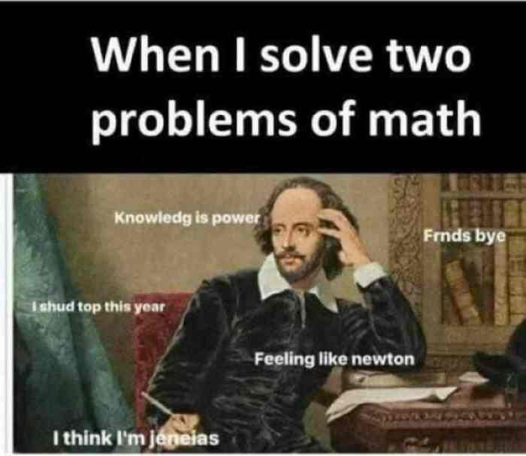

Slide 3
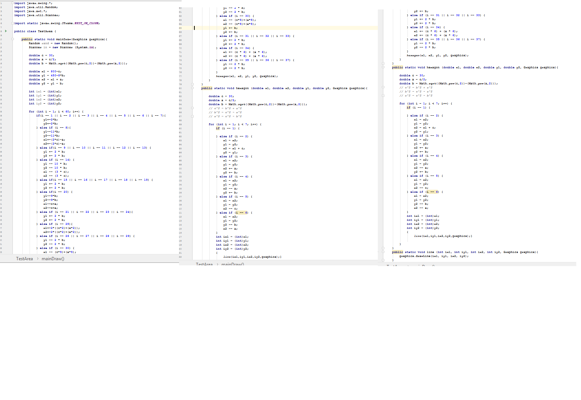


Slide 4


Slide 5
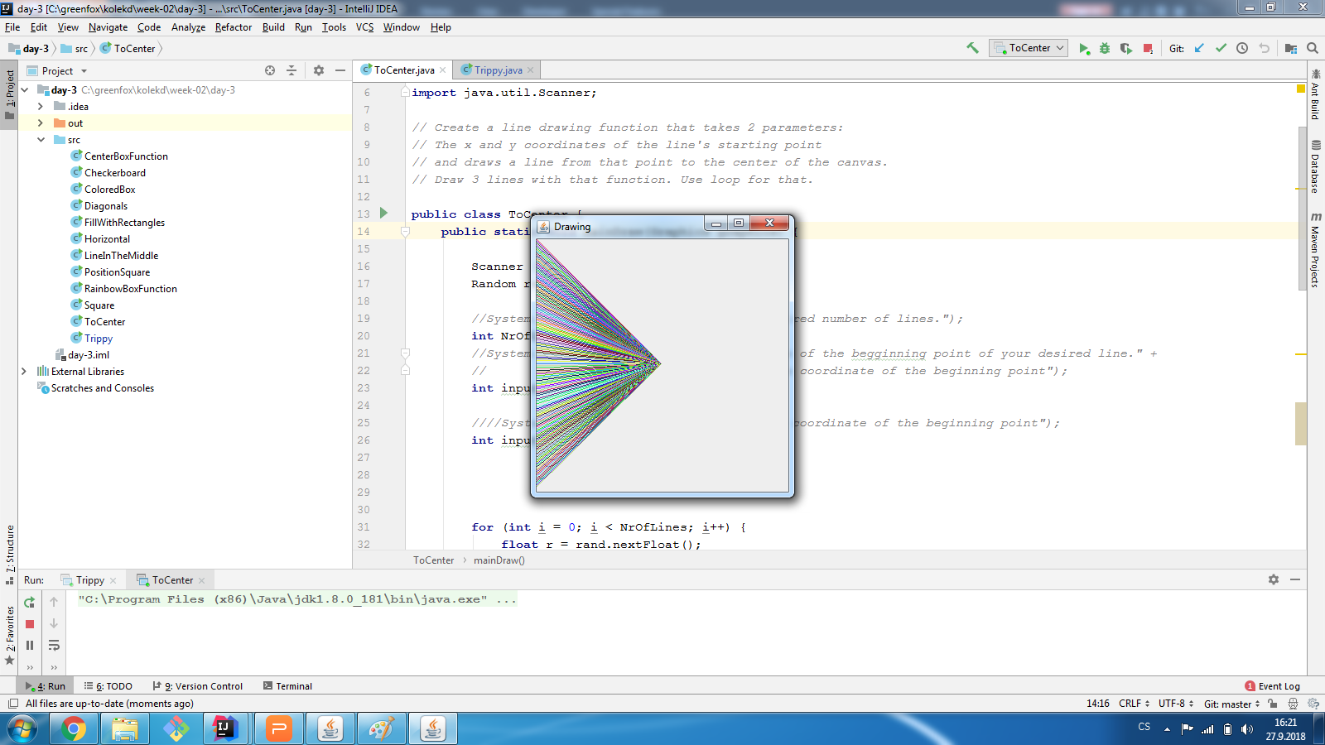

Slide 6
